Slide 1
SUPPLY CHAIN MANAGEMENT

Slide 2
TODAY’S AGENDA
GROUP DETAILS
SUMMARY OF THE PROJECT
KPI LIST
EXCEL DASHBOARD
TABLEAU DASHBOARD
POWERBI DASHBOARD
SQL
SUGGESTIONS
KEY TAKE AWAY

Slide 3
GROUP DETAILS
SUMA
RUTHVIK
SAKSHI
RASAMAI
RAJESH
SANDEEP

Slide 4
SUMMARY OF THE PROJECT
The analysis highlights total sales of 388.13M across multiple states, covering 1,900+ inventory items with an inventory value of 222K+.
Sales demonstrated consistent growth from 2019 to 2022, followed by a noticeable dip in 2023, indicating either partial-year data or a performance shift.
The West region emerges as the top revenue contributor, with strong state-level performance driving overall growth.
Among product categories, Arts & Entertainment leads sales, while Mobiles and Computers contribute comparatively lower revenue.
Debit transactions dominate the purchase methods, accounting for the highest share of total sales.
Store-level analysis shows a few high-performing stores significantly contributing to overall revenue, indicating opportunities for benchmarking best practices.
Business recommendation: Optimize stock by reducing overstocked items and improving availability of high-demand products to drive consistent year-over-year growth.

Slide 5
KEY PERFORMANCE INDICATORS LIST
TOTAL SALES(MTD,QTD,YTD)
PRODUCT WISE SALES
SALES GROWTH
DAILY SALES GROWTH
STATE WISE SALES
TOP 5 STORES WISE SALES
REGION WISE SALES
TOTAL INVENTORY
PURCHASE METHOD WISE SALES
INVENTORY VALUE

Slide 6
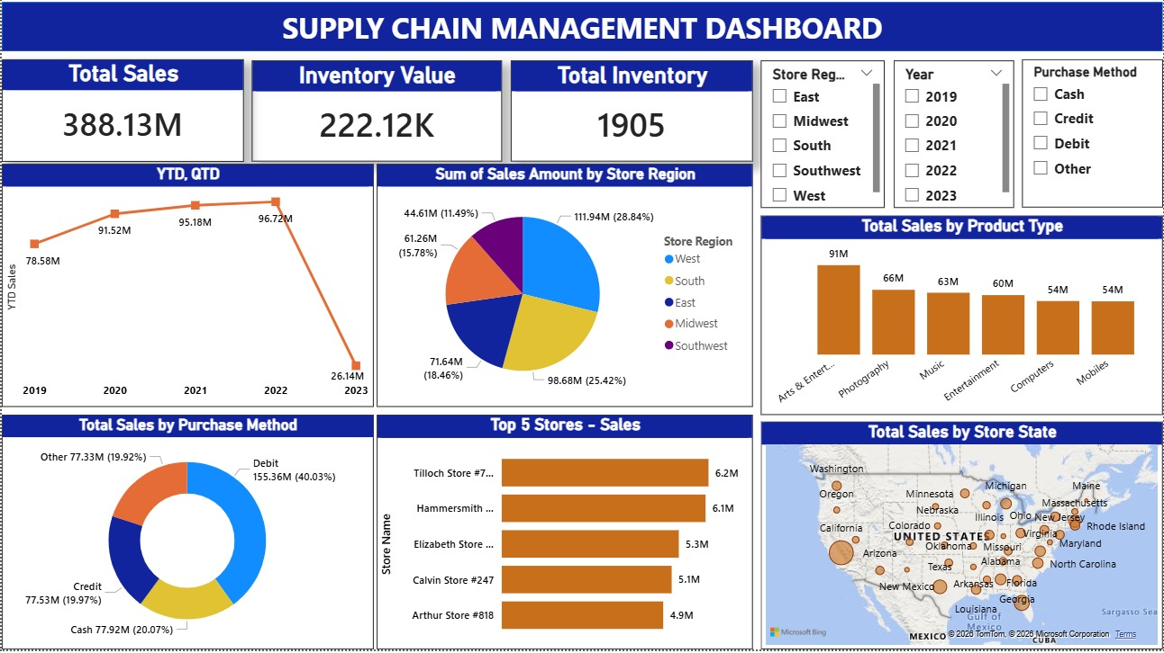
POWER BI DASHBOARD

Slide 7
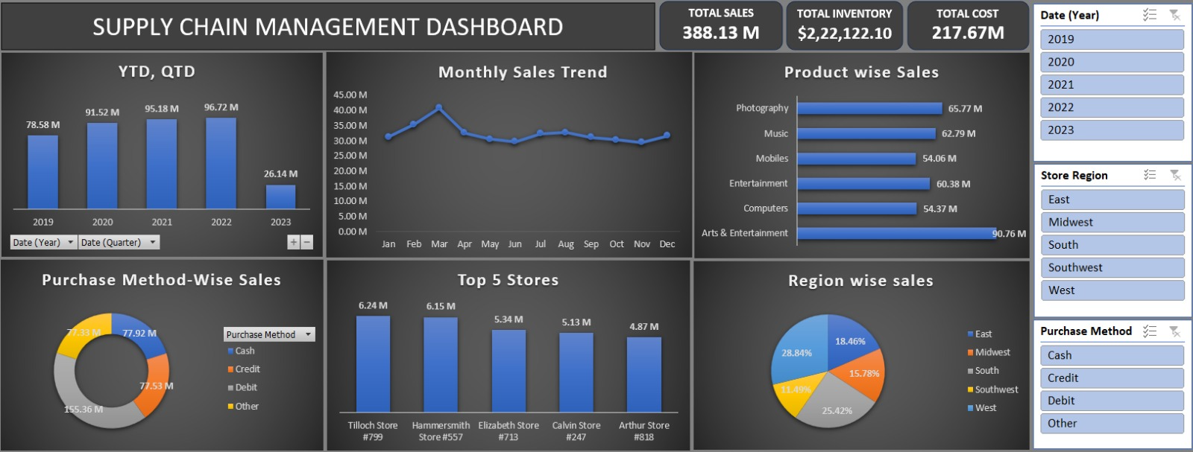
EXCEL DASHBOARD

Slide 8
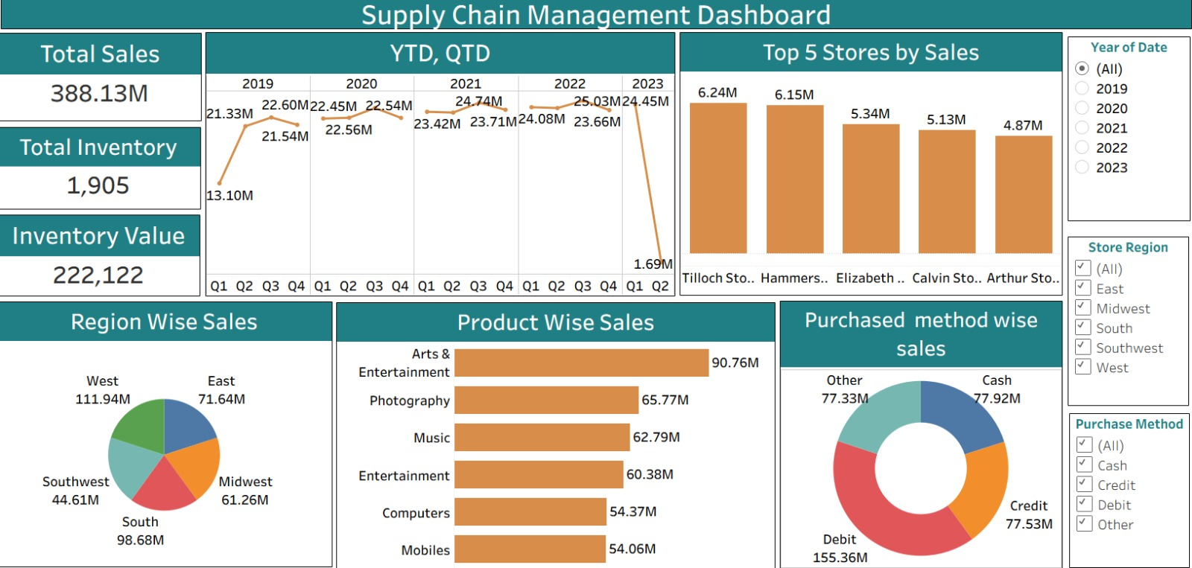
TABLEAU DASHBOARD

Slide 9
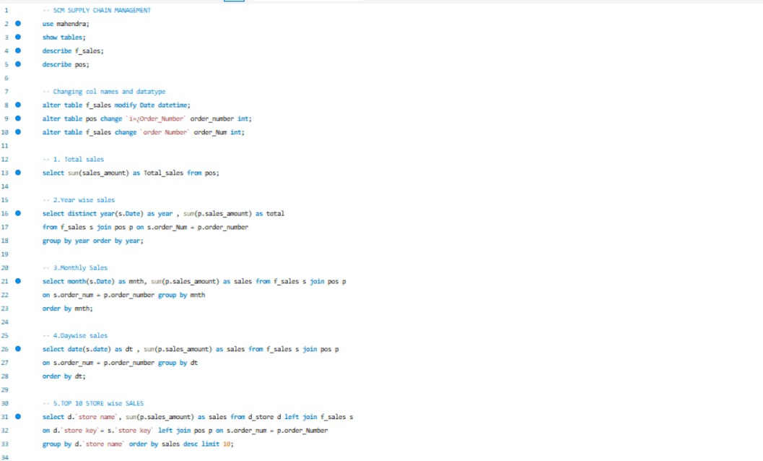
SQL SCRIPT FILE

Slide 10
SUGGESTIONS
Focus on High-Performing Regions
Since the West region and California show strong sales performance, increase marketing investment and inventory availability in these areas to maximize revenue growth.
Improve Low-Performing Stores
New York and other low-performing stores require performance review. Implement targeted promotions, local marketing strategies, and demand-based stocking to improve sales.
Optimize Product Mix
Entertainment products drive the highest revenue, while Mobiles show comparatively lower performance. Adjust product assortment and promotional focus to balance category contribution.
Strengthen Inventory Control
Maintain optimal stock levels by reducing overstocked products and preventing stockouts of high-demand items to improve inventory turnover.
Monitor Sales Trends Regularly
Track MTD, QTD, and YTD sales consistently to quickly identify seasonal changes and adjust pricing or promotional strategies accordingly.
Replicate Best Store Practices
Analyze strategies used by Woodland store (top performer) and implement similar operational practices in underperforming stores.

Slide 11
KEY TAKEAWAY
This project demonstrates how data-driven insights can improve sales visibility, inventory control, and regional performance tracking.
The dashboard enables stakeholders to:
Monitor sales trends across time (MTD, QTD, YTD)
Identify high- and low-performing products and regions
Optimize inventory levels to reduce stock issues
Make informed decisions based on real-time performance insights
Overall, the solution supports smarter supply chain planning and sustainable business growth.

Slide 12
THANK YOU

